Slide 1
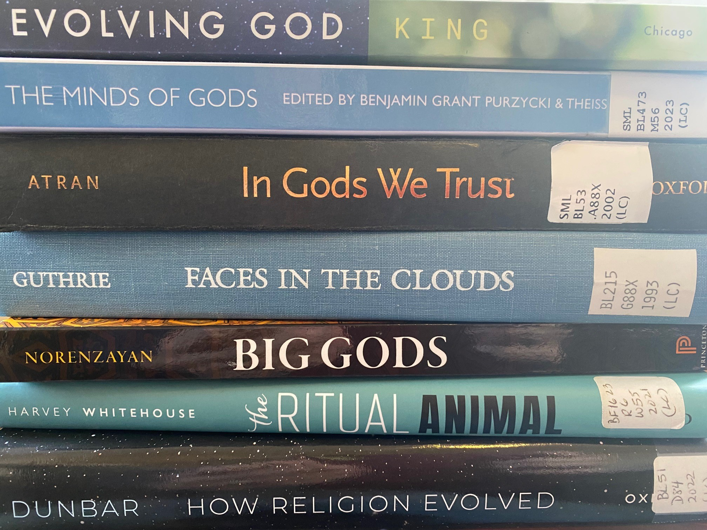
Let’s Talk about God
Religion and Human Evolution Research
Ian Skoggard
Human Relations Area Files at Yale University
Paper Presented at the 84th Annual Meeting of the
Society for Applied Anthropology
March 26-30, 2024, Sante Fe, AZ
Notes:
There is much talk about God these days in the evolutionary sciences, especially in the role that belief in the supernatural plays in the evolution of human sociality, morality and cooperation. Since the turn of this century, a new science calling itself cognitive science of religion (CSR) has sought to explain the origin of religious beliefs. However, in spite of acknowledging religion’s important evolutionary role, these scholars see religion as a cognitive bias. For them religion is not deemed to hold any internal meanings or truths. It seems to me that we are stuck in the age-old impasse of the two cultures, science and religion, the latter considered superstition. I argue in this paper that if science is going to talk about God, then scientists need to consider seriously that gods are part of the realm of consciousness and constitute a subjective reality. Also, I hope to impress on you in this talk that science and religion are closer than you might think. It comes down to a difference in labels. The gods, spirits and the supernatural are just other names for the mind.

Slide 2
The Collective Action Problem (CAP)
Group-living implies interdependence, collective actions, shared benefits, but also conflict of interests between individuals and between individuals and the collective.
With increasing group size, there is increasing heterogeneity which makes cooperation more challenging.
Individual costs to shared benefits.
Notes:
Why all of a sudden this interest in godly beliefs? As I see it, the problem is the Collective Action Problem, originally stated by Mancur Olson over fifty years ago and more recently explored by theoretical biologist Sergey Gavrilets. The CAP simple states that i) group-living implies interdependence, collective actions, shared benefits, but also conflict of interests between individuals and between individuals and the collective; and ii) with increasing group size, there is increasing heterogeneity which makes cooperation more challenging. The collective action problem comes down to simply, “How do we to get people in a diverse population to work together for the benefit of all?” Religion emerged as one solution to the collective action problem.

Slide 3
Religion and the Evolution of Cooperation
Evolution of social instincts occurred among small, egalitarian, reciprocating hunting gathering groups in the Pleistocene.
Tribal social instincts formed at this time became building blocks for evolution of larger, complex societies.
Extension of tribal instincts to larger society through ritual and godly beliefs sanctioned cooperative behavior between groups.
Notes:
In small-scale societies of the Pleistocene, one’s individual work and collective work garnered immediate payoffs. Any surplus was shared and reciprocated. Those who did not share or pulled their weight were shunned. In a process of genetic and cultural coevolution, the mutual benefits of cooperation selected for individuals predisposed to group living and mutuality. It is in this this period that human cooperative spirit and acumen, what Richerson and Boyd call our tribal social instincts, formed and set. In the following period of the Neolithic, a blip in the evolutionary record, a dramatic growth in human population and rise of more complex group living arrangements challenged the limits of tribal instincts. However, humans were clever enough to implement workarounds and extend tribal symbols and sentiments to encompass larger populations, but not completely, as evident in today’s divided political landscape, both nationally and globally.

Slide 4
Cognitive Science of Religion (CSR)
Belief in the supernatural as a cognitive bias that works as an evolutionary exaptation.
Hypervigilance for detecting agents and over attribution of agency
Teleological bias, ascribing function to objects and beings
Theory of mind, attributing like mental and emotional states to others.
Notes:
So where did such godly beliefs come from in the first place? The new cognitive science of religion (CSR) trys to answer this question. These scholars posit that belief in the supernatural is a cognitive bias that nevertheless works as an evolutionary exaptation. Three theories to account for this bias are a hypervigilance for detecting agents such as predators and over attribution of agency to the world including inanimate objects. Another bias is the teleological bias that all things are created for a purpose, for example, a child will say that “rocks are for sitting,” or “mountains are for climbing,” or “clouds are for raining.” A third bias is theory of mind in which individuals attribute their own mental and emotional states to others, including supernatural beings.

Slide 5
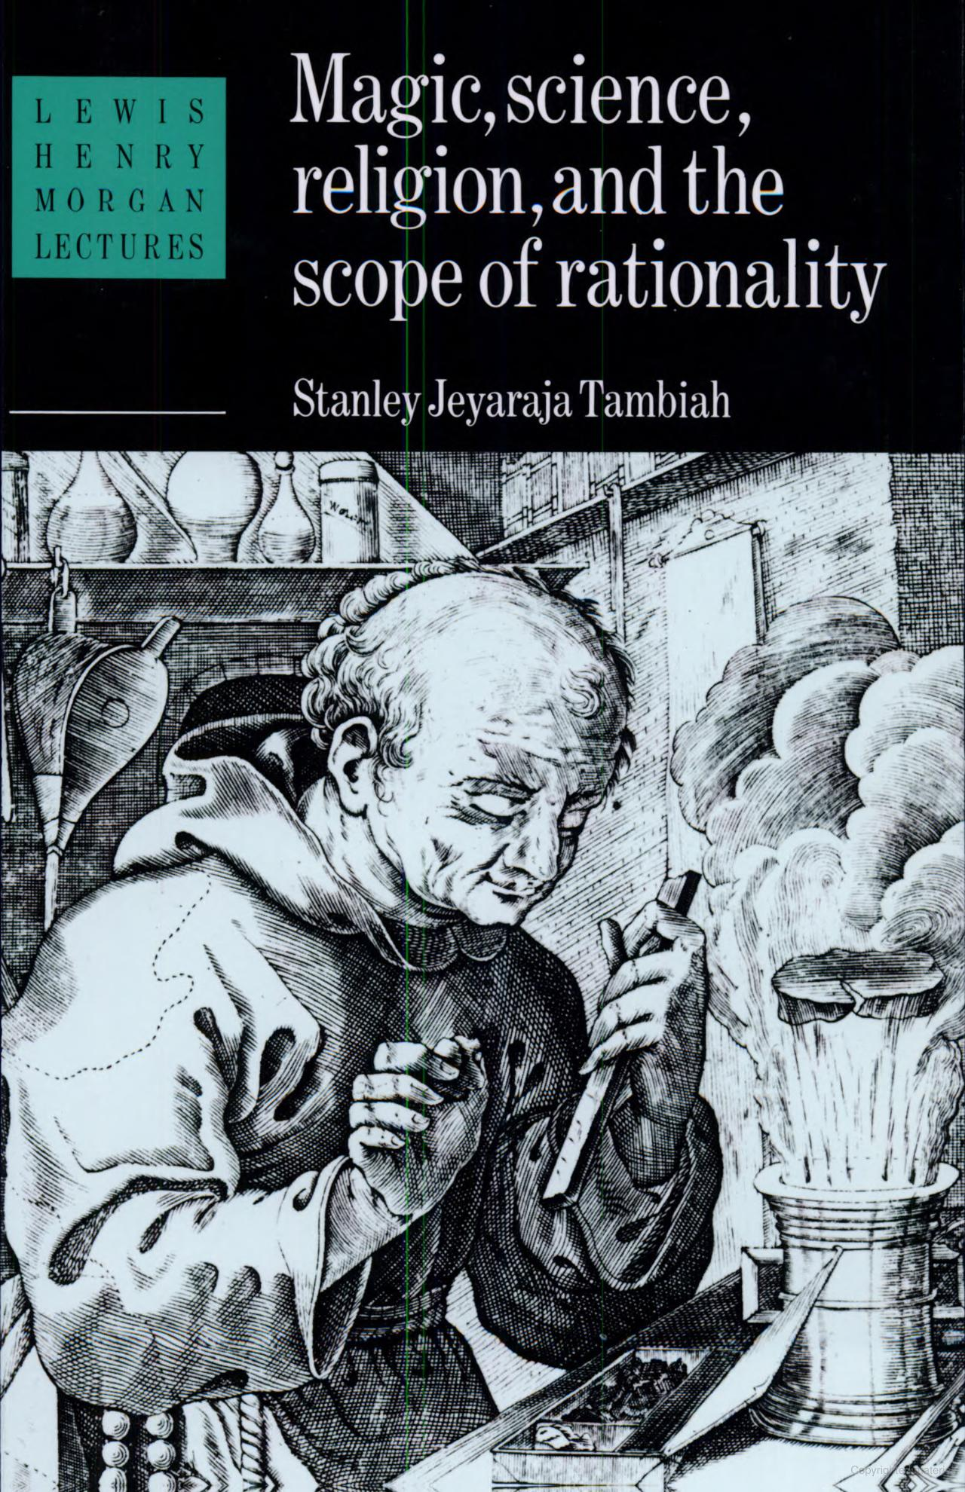
Critique of Science, Part I
Two contrasting, complimentary, and co-existing orientations to the world: one of “participation” (religion) and one of “causality” (science).
Both make use of the same sensory modalities of touch, taste, hearing, seeing.
Social context of science
Notes:
In my mind, the cognitive science of religion does not resolve the science-religion impasse. It comes close, but is still hampered by a scientific bias. This impasse has been a thorn in the side of our discipline since the beginning. What to make of the so-called “primitive” mind. Stanley Tambiah in his 1984 Lewis Henry Morgan lectures wants to bridge the differences between the modern and “primitive” mentalities. He argues that religion and science are two contrasting, complimentary, and co-existing orientations to the world: one of “participation” (religion) and one of “causality” (science). He writes that modern and “primitive” mentalities are not innately different, rather they are different modes of collective thought used in different contexts. Both make use of the same sensory modalities of touch, taste, hearing, and seeing. Also science operates in a social setting in which discoveries are affirmed and theories promoted. Mads Solberg’s monograph, which won the 2021 Carol R. Ember Book Prize, about a science lab investigating salmon lice, brilliantly depicts this collective milieu of scientific reasoning and the need for scientists first to agree on what they are actually seeing and measuring.

Slide 6
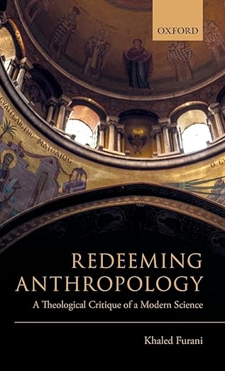
Critique of Science, Part II
Anthropology is the stepchild of theology.
Theology is the investigation of the “all encompassing order of reality.”
Enlightenment reaction against religion shifts focus from divine to the human.
Cannot know the Other without engaging with the ultimate Other.
Anthropologists can only think about God through what the other thinks about god.
Need to take an “antheistic” stance.
Notes:
Another critique of science comes from Kahled Furani, a former student of Talil Asad at City University of New York’s Graduate Program in Anthropology. In his book “Redeeming Anthropology: A Theological Critique of Modern Science,” Furani argues that anthropology is a stepchild of theology, which he defines as the investigation of the “all encompassing order of reality.” Furani argues that the Enlightenment reaction against religion shifted scholarly attention from the divine to the human with anthropologists focusing on the differences between humans. Using the geodesic dome as a metaphor, Furani argues that modern science operates within what he calls the anthropodome, an artificial enclosure that shutters out the theosphere, allowing secular reasoning to operate unchallenged. Furani’s argument is that anthropology cannot truly hope to understand other peoples and cultures, without accepting the divine as a reality. As it stands, anthropologists can only think about the divine through what their subjects think about the divine. He recommends anthropologists to take what he calls an “antheistic” stance, one open to the infinite, that is, being alert to historical contingencies and circumstances.

Slide 7
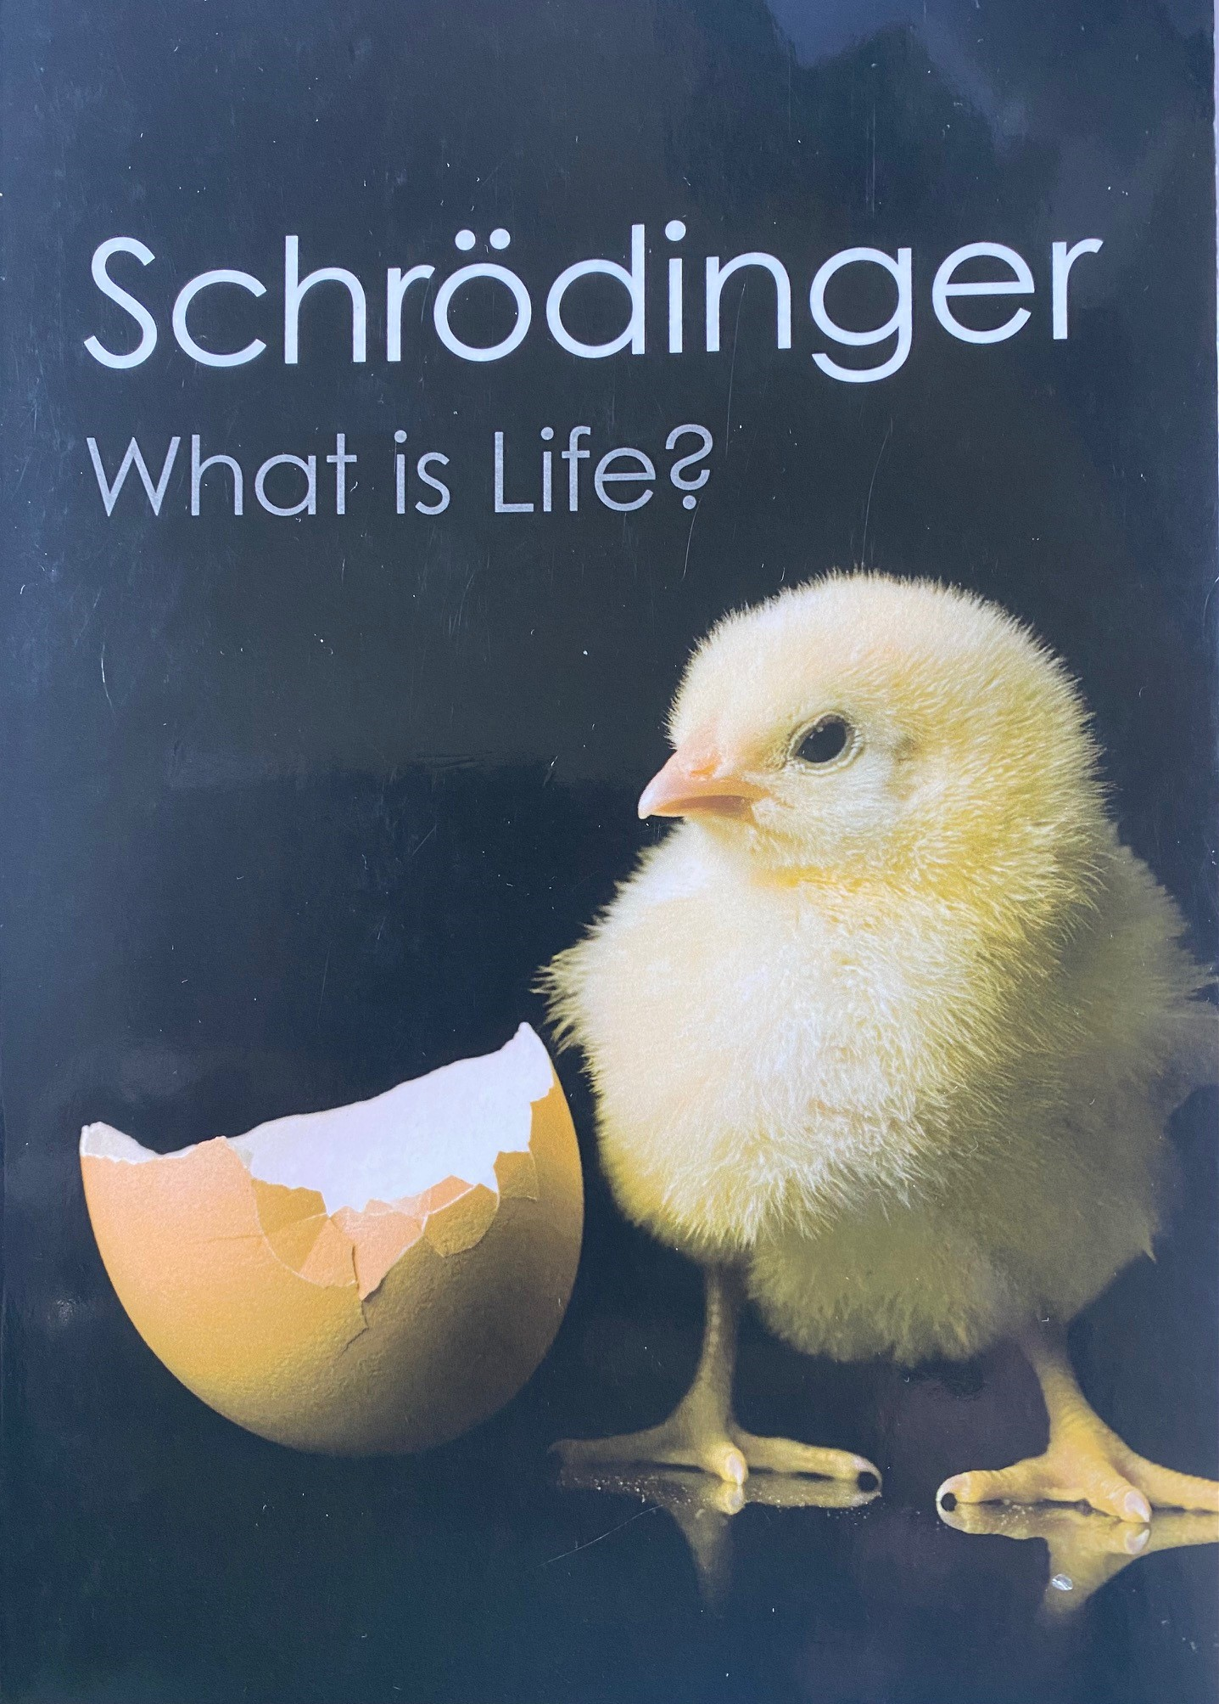
Critique of Science, Part III
Two general principles of the scientific method: understandability of nature and objectivation.
Heisenberg Uncertainty Principle questions the first and “exclusion principle” questions the latter.
Contradiction: Scientific knowledge is based on sense perception and yet science cannot account for sensual qualities.
Notes:
Schrodinger, the eminent quantum physicist, takes the scientific method head on. He questions the objectivism of science. He states that there are two general principles of the scientific method, the understandability of nature and objectivation. Heisenberg Uncertainty Principle questions our ability to know exactly nature at least on the subatomic level. The “exclusion principle” questions scientific objectivism. A fundamental contradiction is that Scientific knowledge is based on sense perception and yet science cannot account for sensual qualities.

Slide 8
Exclusion Principle
“While the stuff from which our world picture is built is yielded exclusively from the sense organs as organs of the mind, so every [person’s] world picture is and always remains a construct of his [or her] mind and cannot be proved to have any other existence, yet the conscious mind itself remains a stranger within this construct, it has no living space in it, you can spot it nowhere in space.”
Schrodinger, Mind and Matter (1956)
Notes:
[read slide] Elsewhere Schrodinger writes that “The total number of minds in the universe is one. In fact, consciousness is a singularity phasing within all beings (Schrodinger 1992, 93),” and “[C]onsciousness is a singular of which the plural is unknown; that there is only one thing and what seems to be a plurality is merely a series of different aspects of this one thing (ibid., 89).”

Slide 9
Notes:
In this ancient Buddhist inscription one could substitute the word “God” for the word “Mind”. Let’s just call “God”, “Mind” and be done with it!

Slide 10
A House Divided Cannot Stand:
Science, Religion and the New Singularity
Need to transcend the science-religion impasse to solve the world problems.
Science provides a necessary lens defining the problem, but religion provides means to motivate and mobilize collective action around a problem.
A belief in one mind, one consciousness is an imperative, is today’s workaround.
Notes:
The British scientist and novelist, C. P. Snow, wrote that science and the humanities which represented "the intellectual life of the whole of western society" had become split into "two cultures" and that this division was a major handicap to both in solving the world's problems. I would make the same argument for science and religion. Science provides a necessary lens defining problems and offering solutions, but religion provides means to motivate and mobilize collective action around the problem and solution. The belief in Schrodinger’s notion of singularity is our current moment’s workaround.

Slide 11
Thank you!
References:
Boyd, R.T. and P.J. Richerson. 2009. Culture and the evolution of human cooperation. Phil. Trans. R. Soc. B 364: 3281-3288
Burdett, E. R. 2023. Growing the minds of gods. In B. G. Purzycki and T. Bendixen, Eds.The Minds of Gods: New Horizons in the Naturalistic Study of Religion. Bloomsbury Academic
Furani, K. 2019. Redeeming Anthropology: A Theological Critique of a Modern Science. Oxford
Gavrilets, S. 2015. Collective action problems in heterogeneous groups. Phil. R. Soc. B 370: 20150016
Schrödinger, Erwin. 1967. What is Life? Cambridge
Solberg, Mads. 2021. A Cognitive Ethnography of Knowledge and Material Culture: Cognition, Experiment, and the Science of Salmon Lice. Palgrave Macmillan
Tambiah, Stanley Jeyaraja. 1990. Magic, Science, Religion, and the Scope of Rationality. Cambridge
Notes:
Thank you!

