Slide 1


An eHRAF Workbook Activity
Divination
&
Oracles
in eHRAF World Cultures
Human Relations Area Files
at Yale University

Slide 2

In this activity
Topics We'll Cover
Understand the concept of divination
Learn about divination and oracles across cultures
Compare and contrast cultural practices
Read and interpret ethnographic data

Slide 3

DIVINATION & ORACLES

Slide 4

Humans are naturally adept decision-makers, taking into account all available knowledge at our disposal and filtering out what we believe to be the most important criteria for our choices.
Every day, each of us makes a series of both small and large decisions. Whether serious or inconsequential, these decisions require weighing pros and cons to arrive at the best path to take. However, we don’t always have all the required information at hand.
Did you know?
Without being able to predict the outcome of our choices before we make them, how can we ever know what to do, or what not to do?

Slide 5

Defining Divination
“A good first way of approaching divination is to consider it as a means of arriving at answers to a personal or social quandary. As such, divination may be diagnostic, in that it offers advice, guidance, rules, and taboos to be followed. It can also be forecasting, by predicting future events, and it may even be interventionist, by intervening in the receptor’s spiritual and physical health or indeed in their destiny.”
(Espirito Santo 2019)

Slide 6
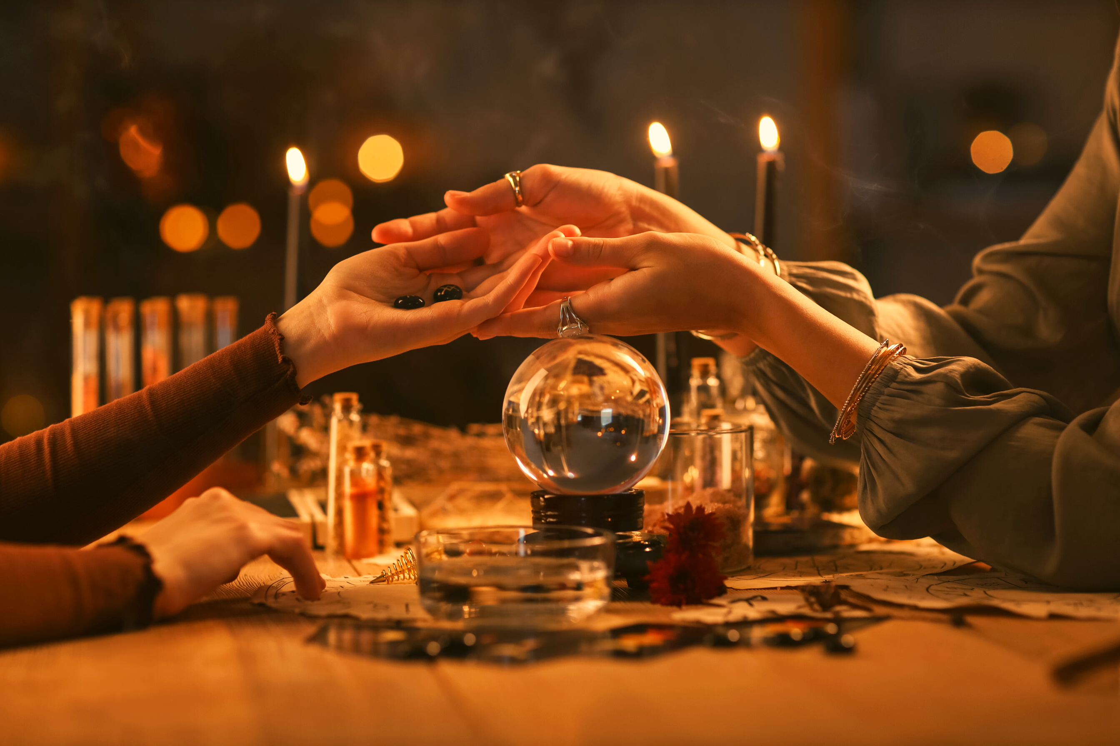
“Techniques of divination come in many forms. Divination often involves the interpretation of patterns or clues – in natural things such as seeds, bones, guts, birds and celestial bodies, as well as in human-made or manipulated things such as cards, dice, images and candles – by means of skilled and usually standardized methods. Divination may also involve more direct commerce with non-human others such as deities, demons or ancestors. Some of the forms of divination [...] call for the use of ceremonial paraphernalia, sacred objects such as altars, candles and texts, or even mathematical tools such as astrolabes and astronomical tables.”
(Aroney and Zeitlyn 2024: 16-18)

Slide 7

CASE STUDY
Mambila Spider Divination
Watch this short video and read the following essay from Professor David Zeitlyn (Oxford University) describing Mambila spider divination:
https://aeon.co/essays/in-cameroon-truth-telling-spiders-untangle-the-future
Then, visit https://nggamdu.org/ to learn more about Mambila diviners (“Meet the Diviners”) and to see videos of the spider oracle in action (“The Spider’s Answers”).
Based on what you have watched and read, answer the following questions:

Slide 8

QUESTIONS
Describe Mambila spider divination: Who may practice it, and what are the steps?
What kinds of questions can be asked to the spider?
What are some questions that shouldn’t be asked, and why?
How are the answers interpreted?
How does Mambila spider divination compare to other types of decision-making tools or practices that you have encountered? Explain your examples.

Slide 9

eHRAF Workbook
ACTIVITY

Slide 10

Read pages 258-264 & 293-301 on Azande poison oracles in Witchcraft, Oracles and Magic among the Azande by Evans-Pritchard (1937)
Azande Poison Oracle
eHRAF link: https://ehrafworldcultures.yale.edu/cultures/fo07/documents/071/pages/269

Slide 11
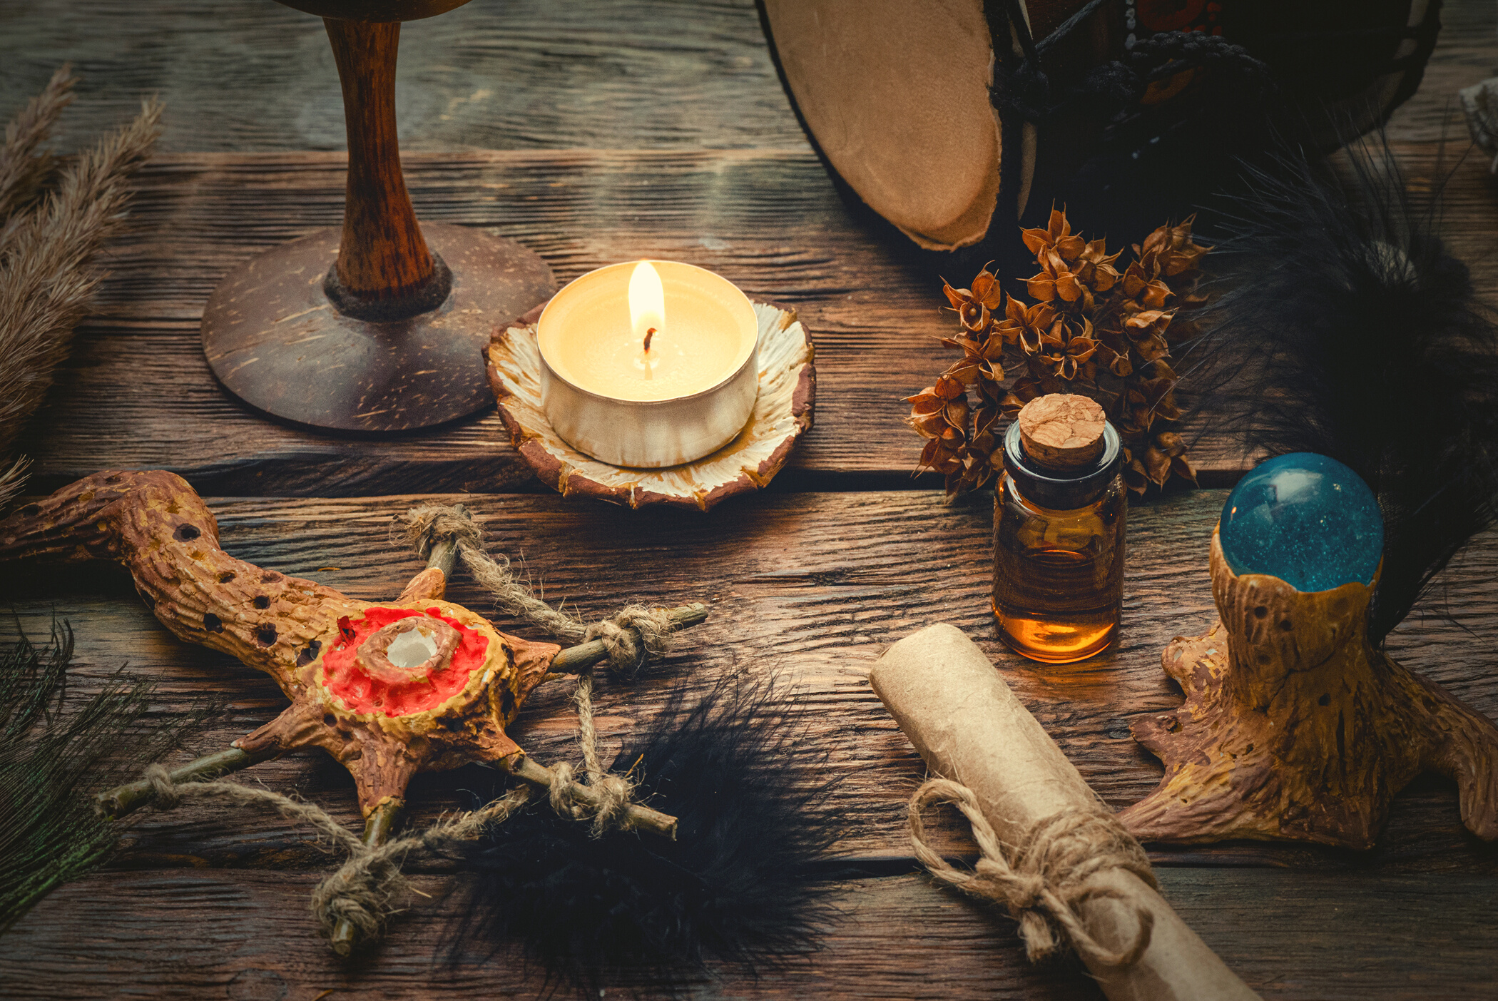
QUESTIONS
Describe the Azande poison oracle. How does it work?
Why is the oracle “one of the most important institutions of social life” for the Azande?
What are some reasons why people might consult the poison oracle?
How is the trustworthiness of an oracle’s verdict determined?
Can you think of any practices or customs in your own society that are similar in any way to poison oracle consultations?

Slide 12
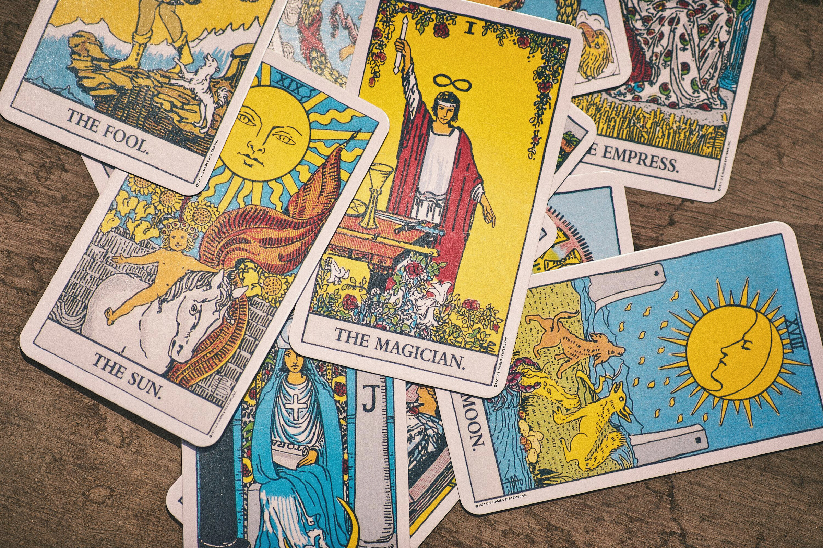
eHRAF Workbook
ACTIVITY

Slide 13
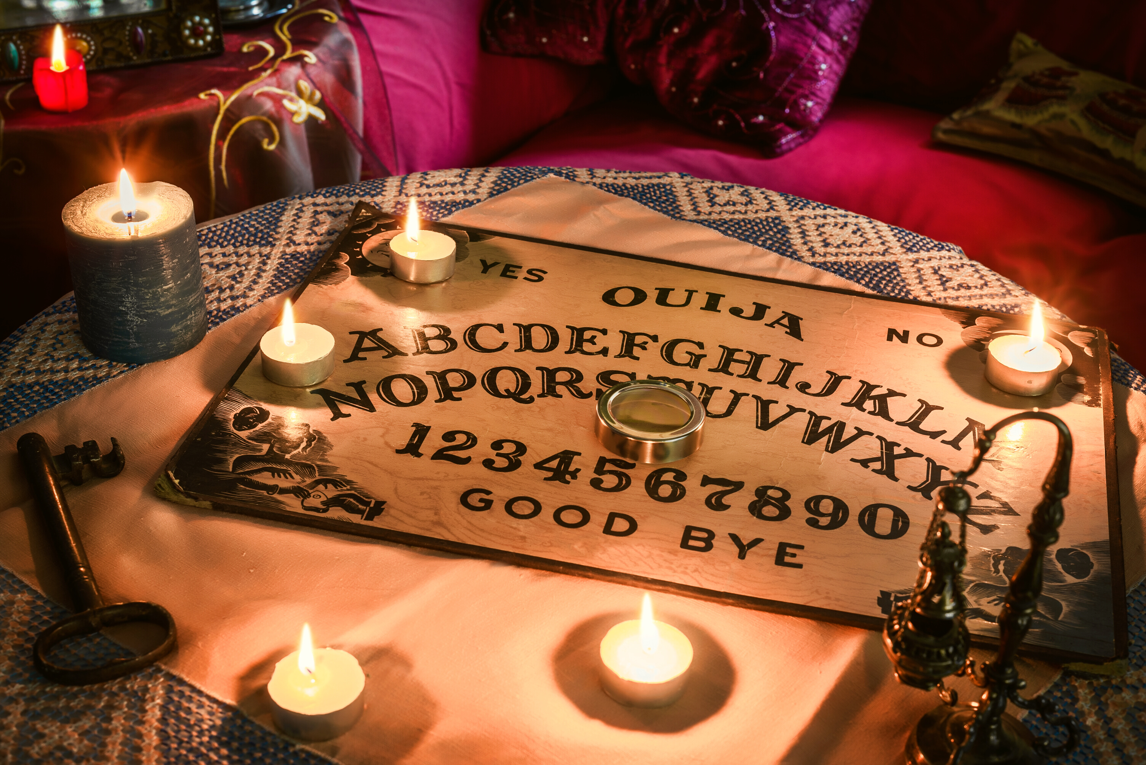
In this activity, you will compare and contrast divination practices and practitioners across cultures using ethnographic evidence from the eHRAF World Cultures database.
Cross-Cultural Comparison
Select one aspect or type of divination to compare across three cultures from different parts of the world. Create a table to store your findings, or add your selected paragraphs to an eHRAF Notebook. Then, write a brief summary comparing your selected cultures.

Slide 14

Research Tips
To get started, identify a feature of divination that interests you. For example, divination using objects such as cards, dice, books or bones; via spirit mediums; or by interpreting omens. You can also focus on divination for diagnosing and explaining illness or bodily harm, or for predicting the outcome of future events.
To begin your research, conduct an Advanced Search in using the OCM subject identifiers: 787 Revelation and Divination and/or 791 Magicians and Diviners. You can also add specific keywords or culture names.
If using eHRAF Notebooks to store your findings, remember that you can annotate and label paragraphs inside your notebook to organize your thoughts. Learn more about Notebooks here.

Slide 15
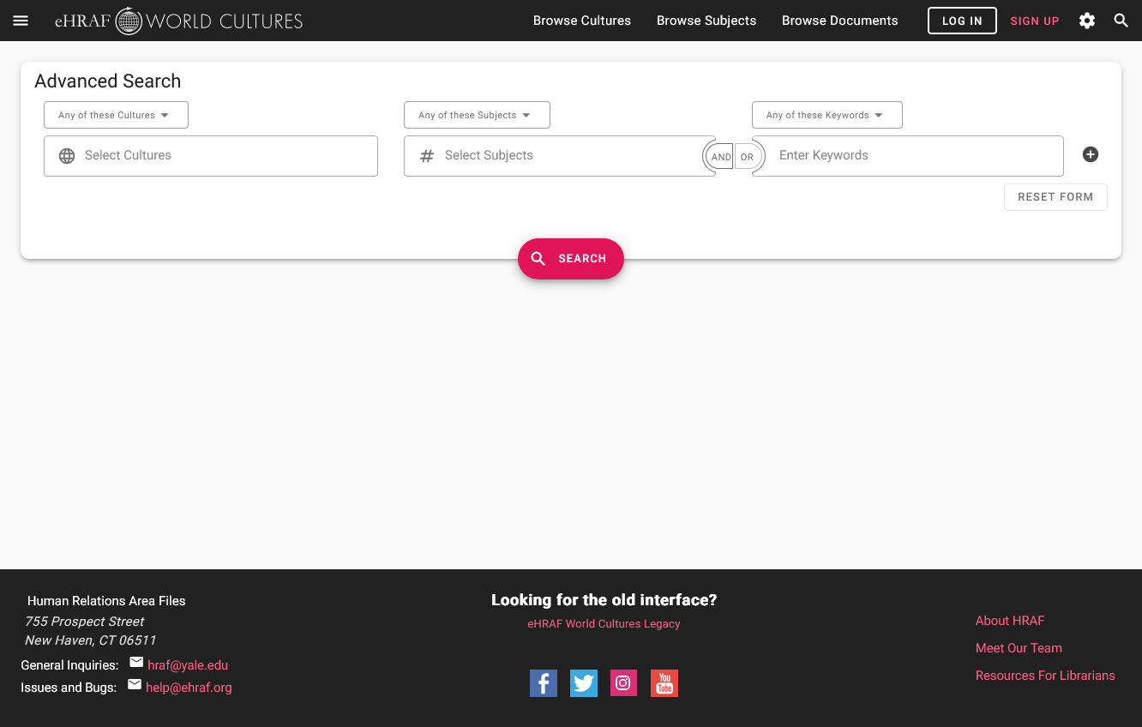
SAMPLE ADVANCED SEARCH
Add 1 or more subjects:
Revelation and Divination (787)
Magicians and Diviners (791)
Add optional keywords such as bones, cards, spirits or scapulimancy

Slide 16
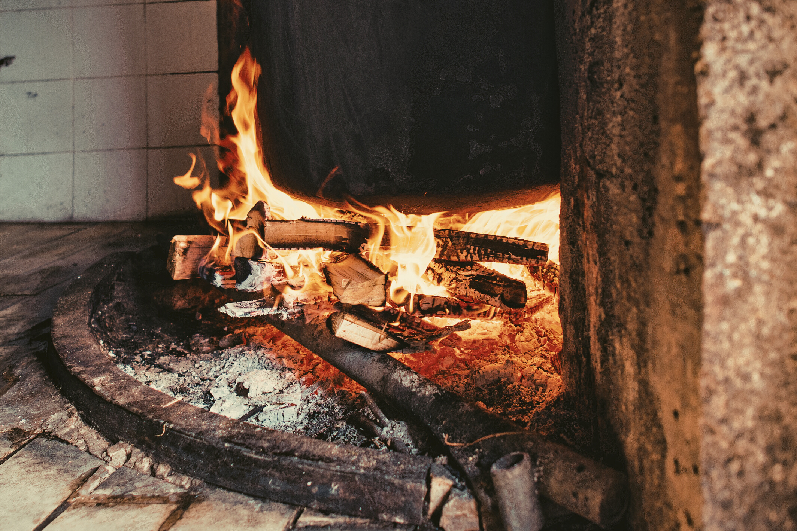
SAMPLE COMPARISON
Scapulimancy
In this example, we will explore scapulimancy: a type of divination that involves reading signs such as cracks or markings that appear on an animal’s shoulder blade bone after it has been burned.
The eHRAF Notebook on the following page contains paragraphs on the subject of scapulimancy.
Log in to eHRAF to view and add this notebook to your Notebooks:
https://ehrafworldcultures.yale.edu/notebooks/c605c220-1986-402e-8261-f18d8fbcc45a

Slide 17
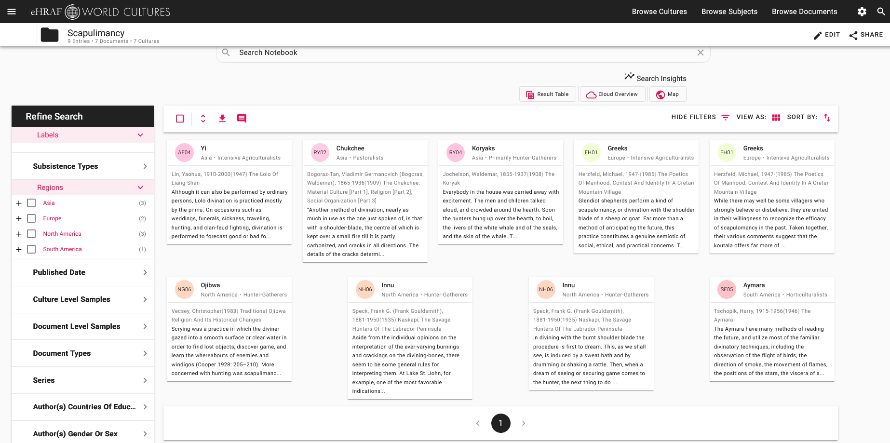
SAMPLE NOTEBOOK: Scapulimancy

Slide 18
1. This activity is based on Divination & Oracles, by Francine Barone, in Teaching eHRAF. https://hraf.yale.edu/teach-ehraf/divination-and-oracles/
2. Aroney, M. and D. Zeitlyn (eds). 2024. Divination: oracles & omens. Oxford: Bodleian Library Publishing
3. Espírito Santo, Diana. (2019) 2023. “Divination”. In The Open Encyclopedia of Anthropology, edited by Felix Stein. Facsimile of the first edition in The Cambridge Encyclopedia of Anthropology.
References
4. Zeitlyn, David. 2025. In Cameroon, truth-telling spiders untangle the future. Aeon.
5. Barone, Francine. 2026. “Coping with Uncertainty: Oracles, Divination and Decision-Making”, Human Relations Area Files at Yale University.

Slide 19
Via Canva Pro License
1. Tarot cards by banusevim from Getty Images
2. Top View of Conjurer Shuffling Oracle Decks by B Dukes from B Dukes
3. Japanese Omikuji Fortune Telling Papers by Aflo Images from アフロ（Aflo）
4. Fortune Cookies by joecicak from Getty Images Signature
5. Magic Eight Ball on Blue Background, Closeup by Africa images
6. Fortune Teller Reading Woman's Palm at Table by pixelshot
7. Paper fortune teller by luknaja from Getty Images Pro
8. Close-up of Mahjong Game Tiles by Teresa Wang from Pexels
9. Intricate astrological chart with zodiac symbols by Delia Pindaru's Images
10. Witchcraft by undefined undefined from Getty Images
11. Colorful Images on Tarot Cards by Aleksandar Pasaric from Pexels
12. Spiritism table with a Ouija board by Fran Rodriguez from Getty Images
13. Shaman by enversengul from Getty Images
14. Burning wood in a stone fireplace by Sofia Gabureanu's Images
Image Credits

Slide 20
Divination
&
Oracles
in eHRAF World Cultures
Produced by
Human Relations Area Files
at Yale University
An eHRAF Workbook Activity
hraf.yale.edu

